Slide 1
Review Sect 4A Graphs of Sine and Cosine Functions
© Copyright all rights reserved to Homework depot: www.BCMath.ca

Slide 2
Review:
In an unit circle, when the terminal arm rotates by θ (degrees/radians) the coordinates of point P on the terminal is given by the equation:
Sin θ is equal to the y-coordinate
Cos θ is equal to the x-coordinate
In a circle with a radius “r” units long, the coordinates of point P on the terminal arm will be:
© Copyright all rights reserved to Homework depot: www.BCMath.ca

Slide 3
Reading Radians with PIE
1 radian is equal to the angle subtended by an arc that is equal to the length of the radius
A full circle is equal to 2π radians, and also 6.28 radians
1 Radian
Ex: Convert each of the following into radians in terms of π
© Copyright all rights reserved to Homework depot: www.BCMath.ca

Slide 4
Ex: Given the following number line, indicate which of the following is the correct value:
y
C
D
B
E
A
x
−1
0
1
2
3
4
5
6
7
8
A
B
C
D
E
© Copyright all rights reserved to Homework depot: www.BCMath.ca

Slide 5
II) Trigonometric and Periodic Functions:
1 Cycle
y
x
Period
Period
Cycle: An interval where a sequence of output values will repeat itself
Period: The length of one cycle.
If “p” is the period
Periodic Function: A function that repeats over a cycle/domain
Amplitude: Difference between the maximum and minimum divided by 2
Sinusoidal Function: A function that behaves like a wave
© Copyright all rights reserved to Homework depot: www.BCMath.ca

Slide 6
Graphing the Sine Function
The sine function y=sinθ begins in the middle: Y-intercept= 0
The range of the function is:
The period of y=sinθ is 2π
The graph peaks at quarter way & lowest at 3quarters way
The X-intercepts occur at 0, 1π, 2π, 3π, 4π, ……..
The Domain is
y
1
0.5
x
0
0.5π
π
1.5π
2π
2.5π
3π
3.5π
4π
-0.5
-1
© Copyright all rights reserved to Homework depot: www.BCMath.ca

Slide 7
Graphing the Cosine Function
The cosine function y=cosθ begins in at the top: Y-int.=1
The range of the function is:
The period of y=cosθ is 2π
The X-intercepts occur at 0.5π, 1.5π, 2.5π, 3.5π, ……..
The Domain is
y
1
0.5
x
0
0.5π
π
1.5π
2π
2.5π
3π
3.5π
4π
-0.5
-1
© Copyright all rights reserved to Homework depot: www.BCMath.ca

Slide 8
Challenge: Which of the following equations is equal to
y
y
x
−0.5π
0
0.5π
π
1.5π
x
−0.5π
0.5π
π
1.5π
2π
−0.5π
0
0.5π
π
1.5π
2π
2π
y
y
−0.5π
0.5π
π
1.5π
x
x
−0.5π
0
0.5π
π
1.5π
2π
−0.5π
0
0.5π
π
1.5π
2π
2π
−0.5π
0.5π
π
1.5π
2π
© Copyright all rights reserved to Homework depot: www.BCMath.ca

Slide 9
When a sine function is shifted one-quarters of it’s period to the left, the function will become a cosine function. Furthermore, if you shift a sine function 3-quarters of it’s period to the right, it will also become a cosine function
Likewise, if you shift a cosine function one-quarter of its period to the right or 3 quarters to the left, it will become a sine function
1
y
Quarter
Period
3 Quarters
Period
−3π
−2π
−π
0
π
2π
3π
x
−4π
4π
-1
1
y
Quarter
Period
3 Quarters
Period
x
−4π
−3π
−2π
−π
0
π
2π
3π
4π
-1
© Copyright all rights reserved to Homework depot: www.BCMath.ca

Slide 10
Co-terminal Angles on Graph:
When given the coordinates of one point, you can find other co-terminal points by adding the period
Note: you only add or subtract the period to the x-coordinate
The y-coordinate will stay the same
y
1
x
−0.5π
0
π
2π
3π
4π
5π
6π
7π
8π
-1
Point separated by the period are known as “coterminal points”
© Copyright all rights reserved to Homework depot: www.BCMath.ca

Slide 11
Review: Graphing the Tangent function
The Tangent function is like a reciprocal function
At points where cosθ = 0, you will get a vertical asymptote because the reciprocal of zero → Undefined
At points where sinθ = 0, you will get a x-intercept
At points where sinθ = cosθ , the value of tanθ will be equal to 1 (ie: 45°, 135°, 225°, and 315°, reference angle equals 45°)
Click to review how to graph a tangent function
© Copyright all rights reserved to Homework depot: www.BCMath.ca

Slide 12
Review: What is the Tangent Function?
The tangent function can be defined as the y-coordinate of the extension of the terminal arm on a vertical tangent line
As the angle changes and increase, the value of tanθ will fluctuate from negative to positive infinity
y
2
x
0
0.5π
π
1.5π
2π
2.5π
3π
3.5π
4π
4.5π
-2
© Copyright all rights reserved to Homework depot: www.BCMath.ca

Slide 13
I) Properties of the Tangent Function:
y
3
2
1
0
π
2π
3π
x
0
π
2π
3π
-1
-2
-3
© Copyright all rights reserved to Homework depot: www.BCMath.ca

Slide 14
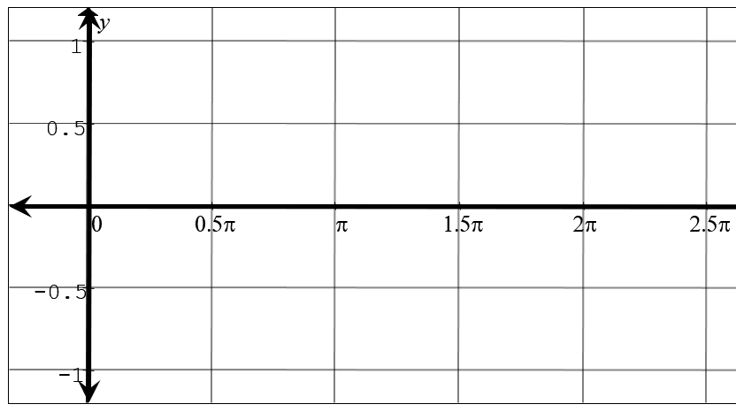
Identities with Phase Shifts

